Slide 1

Unit 13.1 - Data Representation
Prepared by: Koh Kian Hua

Slide 2
Objectives
After completing this unit, students should be able to:
Show understanding of why user-defined types are necessary
Define and use non-composite types
Define and use composite data types
Choose and design an appropriate user-defined data type for a given problem

Slide 3
Data Representation
User-Defined Data Types
Programmers use specific data types that exactly match a program’s requirements.
They define their own data types based on primitive data types provided by a programming language.
These are called user-defined data types.
User-defined data types can be divided into two categories
  Non-composite data types
  Composite data types.

Slide 4
Data Representation
Non-composite Data Types
A non-composite data type can be defined without referencing another data type.
It can be a primitive type available in a programming language or a user-defined data type.
Non-composite user-defined data types are usually used for a special purpose.
We will consider enumerated data types for lists of items and pointers to data in a computer’s memory.

Slide 5
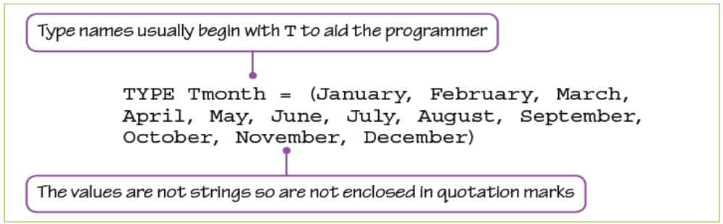
Data Representation
Enumerated Data Types
An enumerated data type contains no references to other data types when it is defined.
In pseudocode, the type definition for an enumerated data type has this structure:
For example, a data type for months of the year could be defined as:

Slide 6
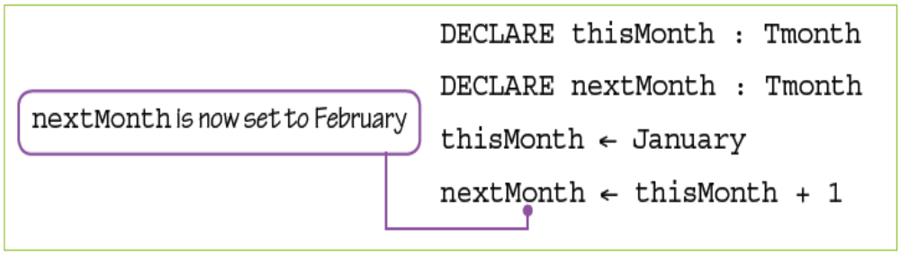
Data Representation
Enumerated Data Types
Then the variables thisMonth and nextMonth of type Tmonth could be defined as:

Slide 7
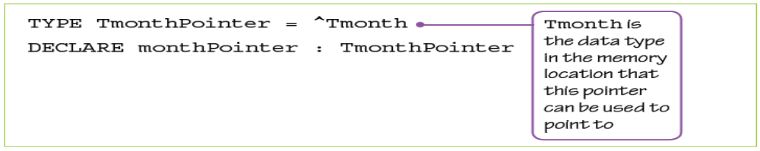
Data Representation
Pointer Data Types
A pointer data type is used to reference a memory location.
This data type needs to have information about the type of data that will be stored in the memory location.
In pseudocode the type definition has the following structure, in which ^ shows that the type being declared is a pointer
<Typename> is the type of data to be found in the memory location, for example INTEGER or REAL, or any user-defined data type.
For example, a pointer for months of the year could be defined as follows:

Slide 8
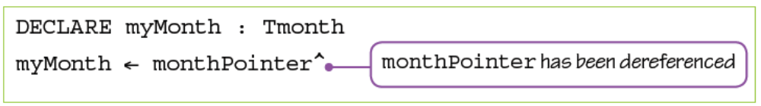
Data Representation
Pointer Data Types
It could then be used as follows:
If the contents of the memory location are required rather than the address of the memory location, then the pointer can be dereferenced.
For example, myMonth can be set to the value stored at the address monthPointer is pointing to:

Slide 9
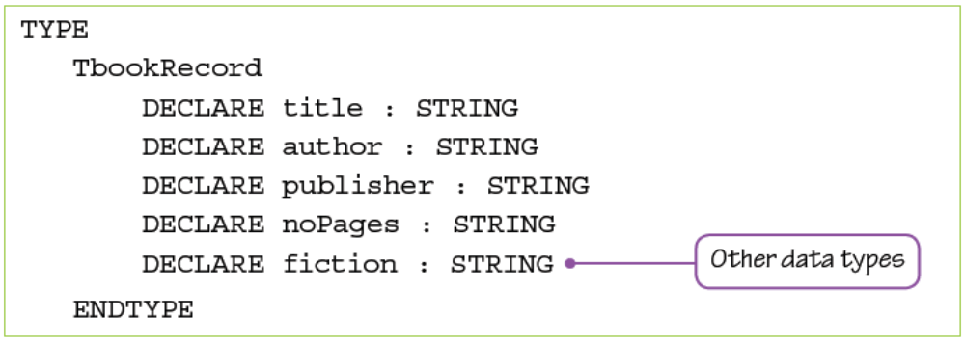
Data Representation
Composite Data Types
A data type that refers to any other data type in its type definition is a composite data type.
In the previous Chapters, the data type for record was introduced as a composite data type because it refers to other data types.
Other composite data types include sets and classes.

Slide 10
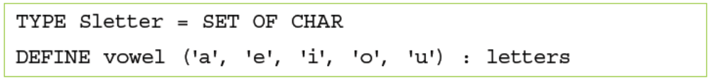
Data Representation
Sets
A set is a given list of unordered elements that can use set theory operations such as intersection and union. A set data type includes the type of data in the set.
In pseudocode, the type definition has this structure:
The variable definition for a set includes the elements of the set.
A set of vowels could be declared as follows:

Slide 11
Data Representation
Classes
A class is a composite data type that includes variables of given data types and methods (code routines that can be run by an object in that class).
An object is defined from a given class; several objects can be defined from the same class.
Classes and objects will be considered in more depth in the later chapters.

Slide 12
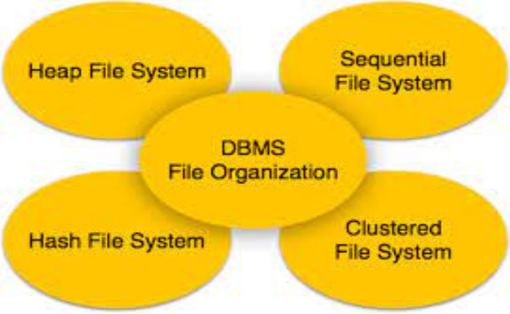
Unit 13.2 - File Organization File Access
Prepared by: Koh Kian Hua

Slide 13
Objectives
After completing this unit, students should be able to:
Show understanding of the methods of file organisation and select an appropriate method of file organisation and file access for a given problem.
Show understanding of methods of file access including sequential access for serial and sequential files and direct access for sequential and random files.
Show understanding of hashing algorithms, and use different hashing algorithms to read from and write data to a random / sequential file.

Slide 14
File Organization & File Access
File Organization
Computers are used to access vast amounts of data and to present it as useful information.
Millions of people expect to be able to retrieve the information they need in a useful form when they ask for it.
This information is all stored as data in files, everything from bank statements to movie collections.
These files can be organised using different methods.

Slide 15
File Organization & File Access
File Organization
Computers are used to access vast amounts of data and to present it as useful information.
Millions of people expect to be able to retrieve the information they need in a useful form when they ask for it.
This information is all stored as data in files, everything from bank statements to movie collections.
These files can be organised using different methods.
  Sequential file organization
  Random file organization

Slide 16
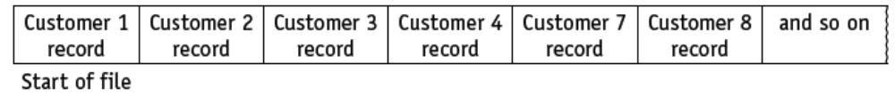
File Organization & File Access
Sequential File Organization
This method physically stores records of data in a file, one after another, in a given order.
The order is usually based on the key field of the records as this is a unique identifier (eg: customer number).
All records are stored in ascending customer number order, where the customer number is the key field that uniquely identifies each record.
New records must be added to the file in the correct place; for example, if Customer 5 is added to the file, the structure becomes:

Slide 17
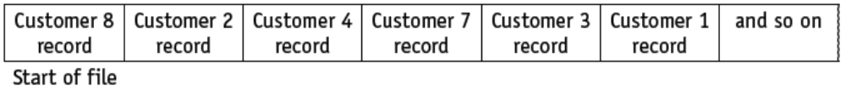
File Organization & File Access
Random File Organization
The random file organisation method physically stores records of data in a file in any available position.
The location of any record in the file is found by using a hashing algorithm on the key field of a record.

Slide 18
File Organization & File Access
File Access
There are different methods of file access (the method used to physically find a record in the file).
We will consider two of them: sequential access and direct access.

Slide 19
File Organization & File Access
Direct Access
The direct access method can physically find a record in a file without other records being physically read. Both sequential and random files can use direct access.
This allows specific records to be found more quickly than using sequential access.
Direct access is required when an individual record from a file needs to be processed. eg: when a single customer record needs to be updated when the customer’s phone number is changed.
For a sequential file, an index of all the key fields is kept and used to look up the address of the file location where a given record is stored.
For a random access file, a hashing algorithm is used on the key field to calculate the address of the file location where a given record is stored.

Slide 20
File Organization & File Access
Hashing Algorithm
In the context of storing and accessing data in a file, a hashing algorithm is a mathematical formula used to perform a calculation on the key field of the record.
The result of the calculation gives the address where the record should be found.
More complex hashing algorithms are used in the encryption of data.

Slide 21
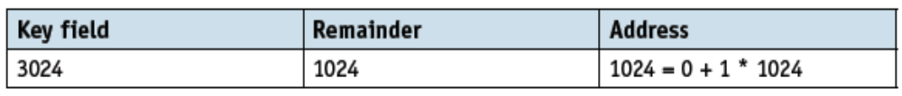
File Organization & File Access
Hashing Algorithm (Example)
If a file has space for 2000 records and the key field can take any values between 1 and 9999, then the hashing algorithm could use the remainder when the value of key field is divided by 2000, together with the start address of the file and the size of the space allocated to each record.
In the simplest case, where the start address is 0 and each record is stored in one location.
To store a record identified by a key field with value 3024, the hashing algorithm would give address 1024 as the location to store the record.

Slide 22
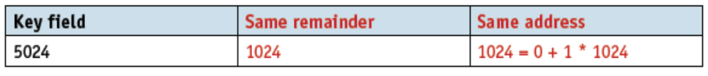
File Organization & File Access
Hashing Algorithm (Example)
However, storing another record with a key field 5024 would result in trying to use the same file location and a collision would occur.
This often happens with hashing algorithms for direct access to records in a file.
There are two ways of dealing with this:
  An open hash where the record is stored in the next free space.
  A closed hash where an overflow area is set up and the record is stored in the next free space in the overflow area.

Slide 23
File Organization & File Access
Class Activity (Homework)
1) Explain, using examples, the difference between composite and
non-composite data types.
2) Explain why programmers need to define user-defined data types.
Use examples to illustrate your answers.

